Slide 1
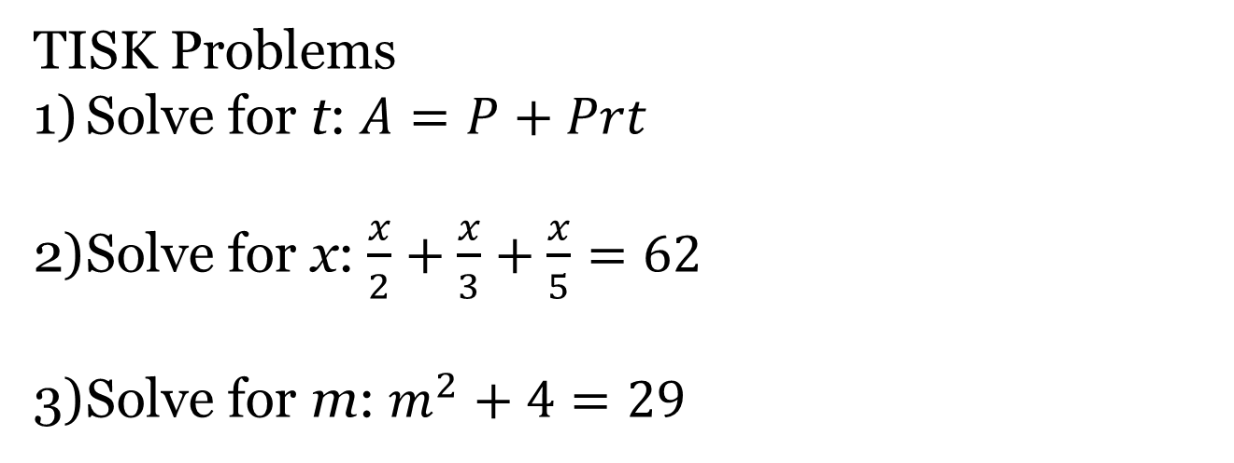
Tuesday, December 4, 2012
Agenda:
TISK Problems/No MM
Homework Check
Lesson 11-2: Slope of a Line
Homework: Finding the Slope of a Line worksheet
TISK Problems
Solve for t: $A=P+Prt$
Solve for x: $\frac{x}{2}+\frac{x}{3}+\frac{x}{5}=62$
Solve for m: $m^{2}+4=29$

Slide 2
Homework Check
We will check homework at the END of the lesson today.

Slide 3
A bug is crawling along a piece of paper.
How do we describe the bug’s path?
He’s traveling in a straight line!
How can we describe his line as opposed to another bug…?
The red bug climbs up 3 units for every 4 units he crawls to the right.
The green bug climbs up 5 units for every 2 units he crawls to the left.
The way they move is called the SLOPE of the line.

Slide 4
So, what do you know?
Slope is…
The climb compared to the crawl of a line
The change in y compared to the change in x.
How a line moves.
The rise compared to the run of a line.

Slide 5

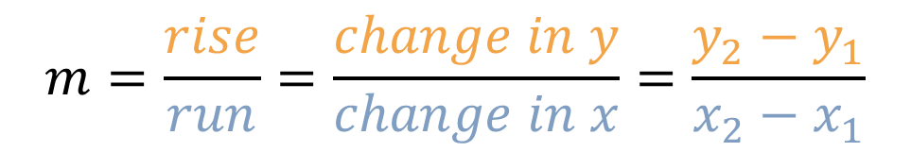
Slope Equation
The formula for slope of any line with points $\left(x_{1},y_{1}\right)$ and $(x_{2},y_{2})$ is:
$$m=\frac{rise}{run}=\frac{change in y}{change in x}=\frac{y_{2}−y_{1}}{x_{2}−x_{1}}$$

Slide 6
Finding Slope
Find the slope of a line that passes through the points (-3, 5) and (7, 6).
-3
5
6
7

Slide 7
Finding Slope
Find the slope of a line that passes through the points (-8, -6) and (7, -9).
-8
-6
-9
7

Slide 8
Find the slope of the line.
9
Up = + Right = +
Down = - Left = -
8
-9
-8

Slide 9
Find the slope of the line.
-2
10

Slide 10
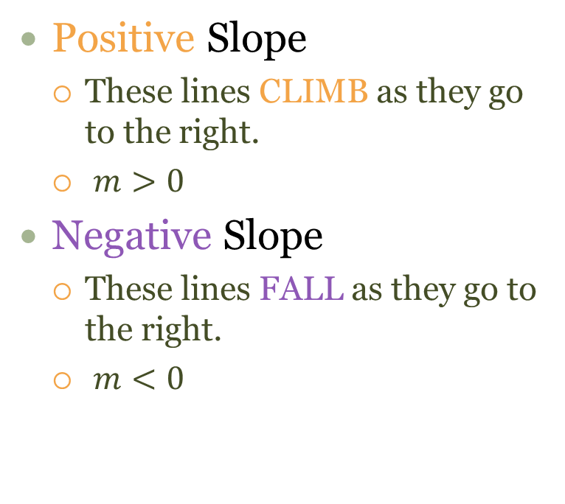
Classify Lines by Slope
Positive Slope
These lines CLIMB as they go to the right.
$m>0$
Negative Slope
These lines FALL as they go to the right.
$m<0$

Slide 11
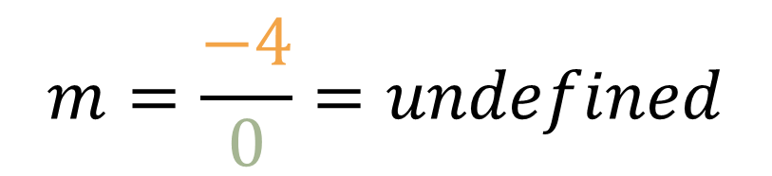

Quick Look…
What happens to the slope of a horizontal line?
0
10
What about a vertical line?
$$m=\frac{0}{10}=0$$
-4
$$m=\frac{−4}{0}=undefined$$
0

Slide 12
Classify Lines by Slope
Zero Slope
These lines are horizontal
No Slope
These lines are vertical

Slide 13
Tell whether each line has a positive, negative, undefined, or zero slope.

Slide 14
Homework Check

